Slide 1
Controlling the Scheduling of Alma Scheduled Jobs
Yoel Kortick
Yoel.Kortick@clarivate.com

Slide 2
Agenda
  Introduction
  Types of scheduling mechanisms
  Scheduling Jobs with an open list of scheduling options
  Scheduling Jobs with a closed list of scheduling options

Slide 3
Introduction

Slide 4
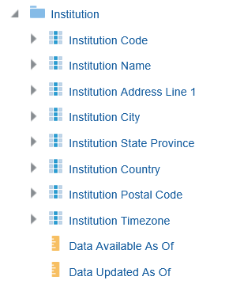

Introduction
Alma provides a flexible mechanism to control the frequency and timing of scheduled jobs.
It is possible to set selected jobs to run either Hourly, Daily, Weekly, or Monthly.
When specifying a time (hour) for the job to run, the time on which the job runs is determined by the value of the timezone parameter defined for the institution.
  The timezone is set during the implementation process
  If the institution wants to see their timezone it can be viewed in Alma Analytics in the shared "Institution" folder.
This institution for example is in timezone CET (Central European Time)

Slide 5
Introduction
In addition to this presentation see the Online help Controlling the Scheduling of Alma Scheduled Jobs

Slide 6
Types of scheduling mechanisms

Slide 7
Types of scheduling mechanisms
For some jobs, a mechanism exists whereby the staff user can choose whether the job will run Weekly or Monthly. In some cases, there is also an "Hourly" and some cases also a "Daily" option. When choosing one of these options the staff user can choose the specific hour and other time-related parameters in which the job will run.
  For the purposes of this presentation, we will call this an "open list of scheduling options"
For other jobs, there is a pull-down box from which staff users can choose a predefined list of times for the jobs to run, and a different option than what appears in the pull-down box cannot be chosen.
  For the purposes of this presentation, we will call this a "closed list of scheduling options"

Slide 8
Types of scheduling mechanisms
We will now show the scheduling mechanism for:
Three examples of a job with an "open list of scheduling options"
  General Publishing Profile
    includes four options: Hourly, Daily, Weekly, or Monthly
  Send Courtesy Notices and Handle Loan Renewals
    includes three options: Daily, Weekly and Monthly
  Borrowing Activity Report
    includes two options: Weekly and Monthly
Two examples of a job with a "closed list of scheduling options"
  Send Overdue Notices
  SUSHI harvesting job

Slide 9
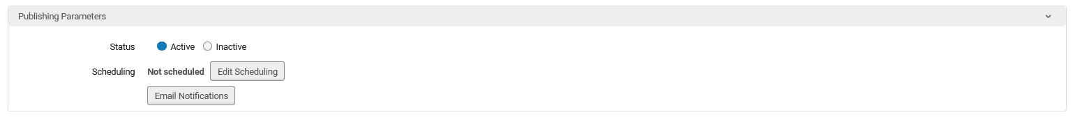
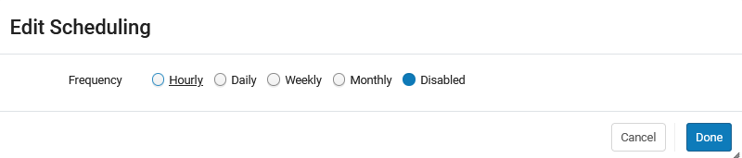
Types of scheduling mechanisms
For example, the General Publishing Profile includes an "open list of scheduling options" which includes four options: Hourly, Daily, Weekly, or Monthly
We will click "edit scheduling"
We see options for Hourly, Daily, Weekly and Monthly
We will soon see that after choosing a "Frequency" option, additional parameters must be chosen (for example if "Monthly" is chosen here, then afterwards a specific day of the month must be chosen)

Slide 10
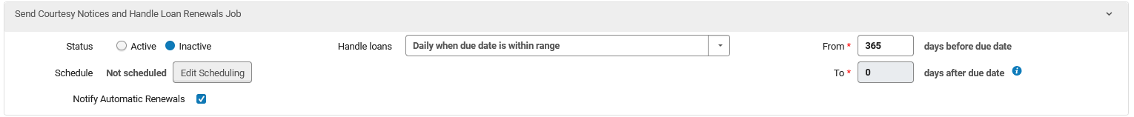
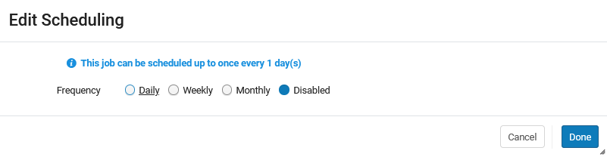
Types of scheduling mechanisms
The job "Send Courtesy Notices and Handle Loan Renewals" also includes an "open list of scheduling options". It includes three options: Daily, Weekly and Monthly. It does not include Hourly.
We will click "edit scheduling"
We will soon see that after choosing a "Frequency" option, additional parameters must be chosen (for example if "Daily" is chosen here, then afterwards a specific hour of the day must be chosen)

Slide 11
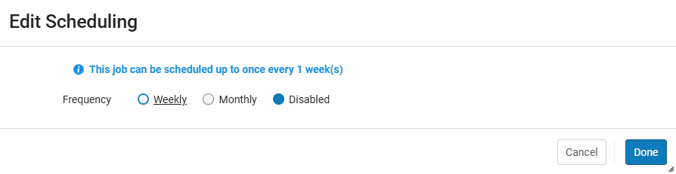
Types of scheduling mechanisms
The job "Borrowing Activity Report" also includes an "open list of scheduling options". It includes two options: Weekly and Monthly. It does not include Daily or Hourly.
We will click "edit scheduling"
We will soon see that after choosing a "Frequency" option, additional parameters must be chosen (for example if "Weekly" is chosen here, then afterwards a specific day of the week must be chosen)

Slide 12
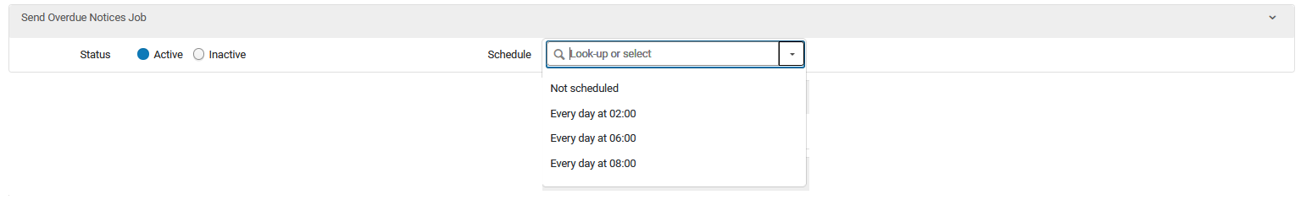
Types of scheduling mechanisms
The job "Send Overdue Notices" is a "closed list of scheduling options". It includes a predefined list of scheduled options, and a different option cannot be created or used.
There is no option to click "edit scheduling" and there is a closed list of possible times for the job to run.

Slide 13
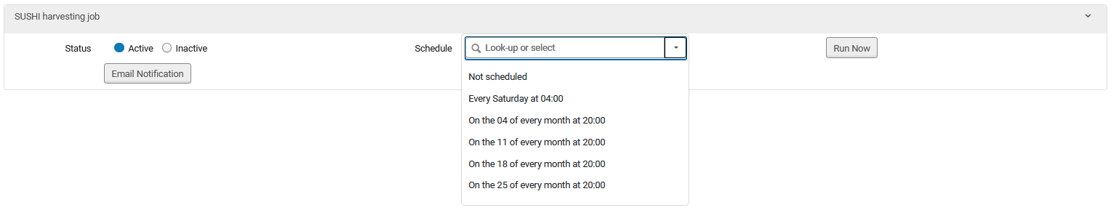
Types of scheduling mechanisms
The job "SUSHI harvesting job" is a "closed list of scheduling options". It includes a predefined list of scheduled options, and a different option cannot be created or used.
There is no option to click "edit scheduling" and there is a closed list of possible times for the job to run.

Slide 14
Scheduling Jobs with an open list of scheduling options

Slide 15
Scheduling Jobs with an open list of scheduling options
We will now do two examples to show how to schedule a job with an open list of scheduling options.
Example 1: the manual job "Export Physical items"
Example 2: the automated job "Borrowing Activity Report job"

Slide 16
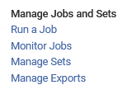
Scheduling Jobs with an open list of scheduling options
Example 1
We will use the following example to show how to schedule a job with an open list of scheduling options.
Every day at 06:00 AM the job "Export Physical items" will run on a logical set called "physical items created in the last day"
This is a "manual job" accessed via "Admin > Manage Jobs and Sets > Run a Job"

Slide 17
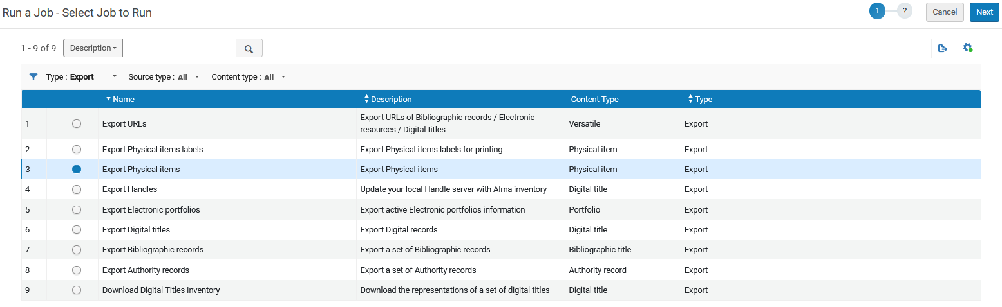
Scheduling Jobs with an open list of scheduling options
Example 1
Here we have filtered by type "Export" and chosen the job "Export Physical items"

Slide 18
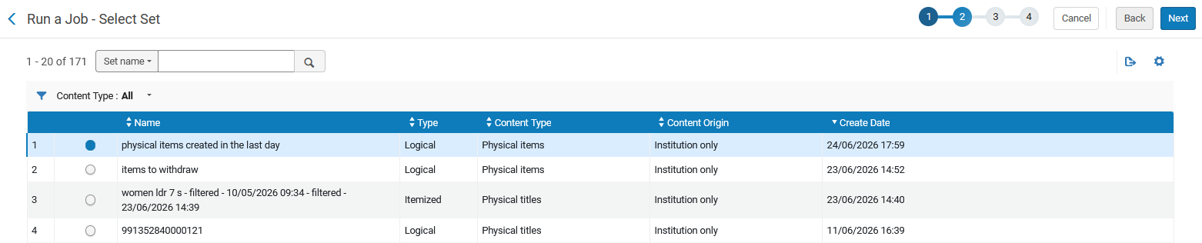
Scheduling Jobs with an open list of scheduling options
Example 1
Here we choose the desired set "physical items created in the last day"

Slide 19
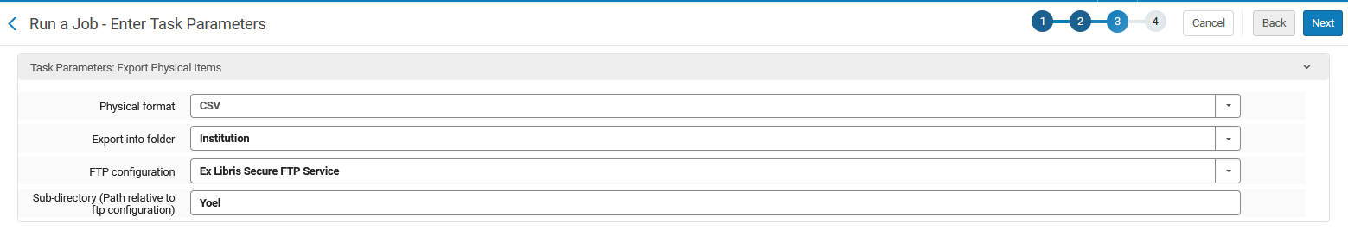
Scheduling Jobs with an open list of scheduling options
Example 1
We fill in additional parameters as necessary

Slide 20
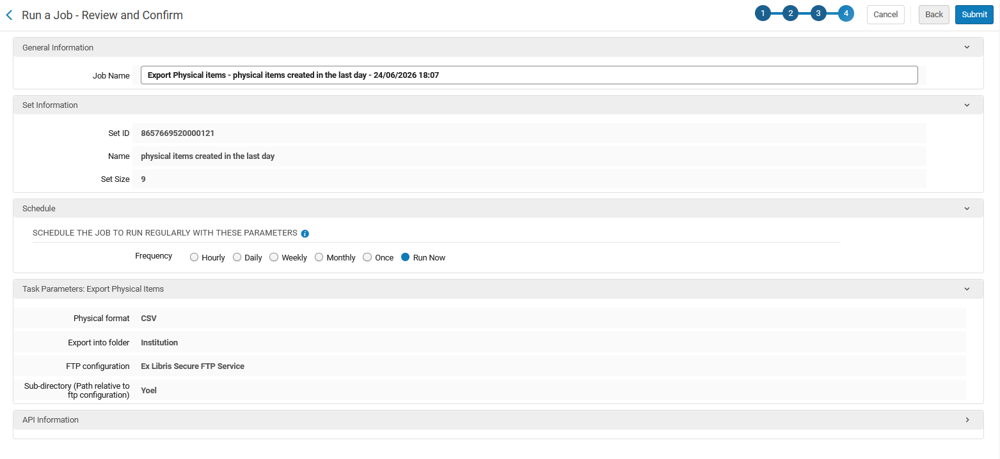
Scheduling Jobs with an open list of scheduling options
Example 1
Instead of the default "Run Now" we will choose "Daily".
After doing so additional options will appear.

Slide 21
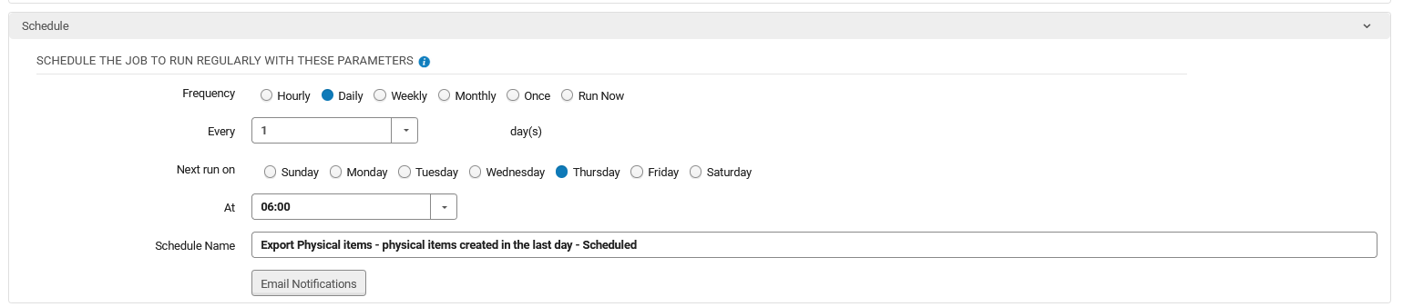
Scheduling Jobs with an open list of scheduling options
Example 1
We have chosen as follows:
  It will run every 1 day at 06:00 AM and the next run will be on Thursday.
  In the list if scheduled jobs it will appear as ""Export Physical items - physical items created in the last day – Scheduled"
This is how the job will appear in the list of scheduled jobs.

Slide 22
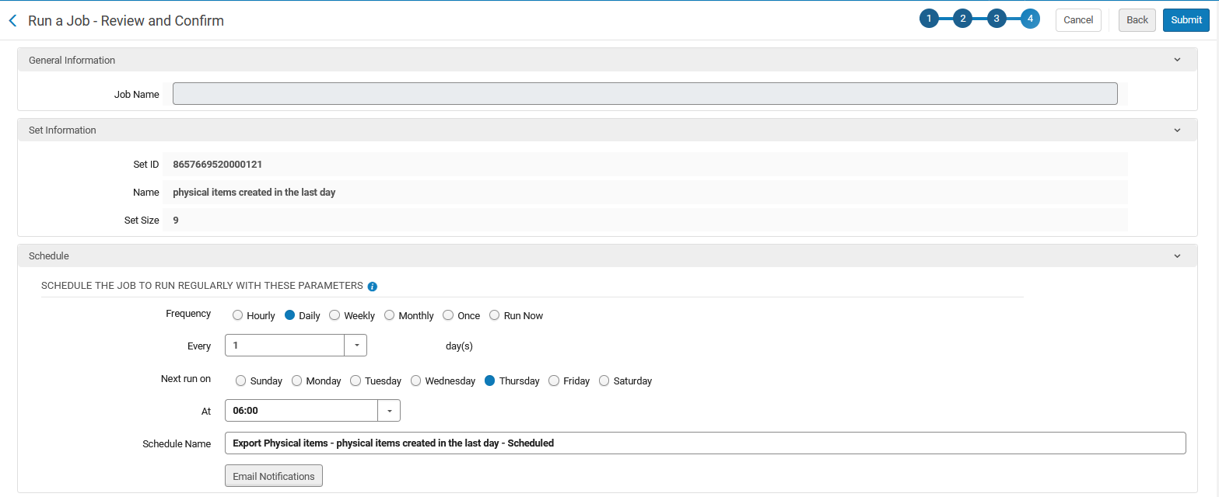
Scheduling Jobs with an open list of scheduling options
Example 1
We submit the job

Slide 23
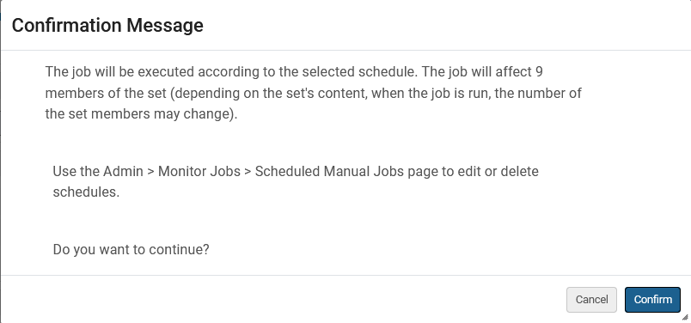
Scheduling Jobs with an open list of scheduling options
Example 1
We are notified that "The job will be executed according to the selected schedule." and we confirm

Slide 24
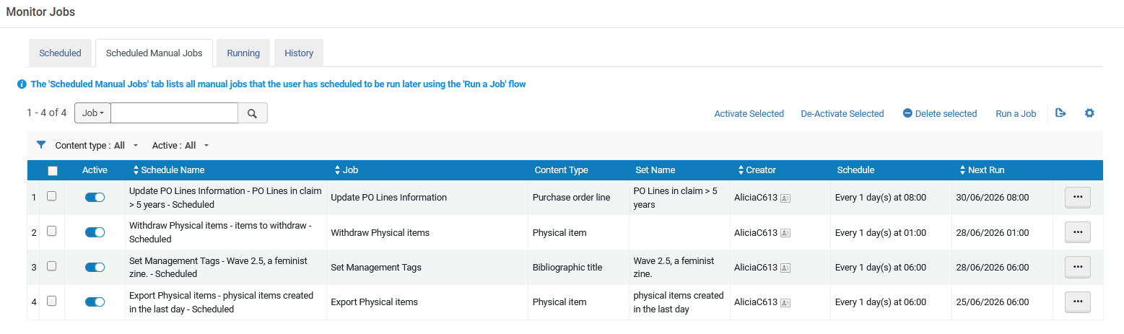
Scheduling Jobs with an open list of scheduling options
Example 1
Because this is a manual job, it appears in the "Scheduled Manual Jobs" tab at "Admin > Manage Jobs and Sets > Monitor Jobs"
These are the scheduling options we chose.

Slide 25
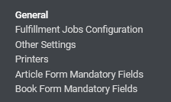
Scheduling Jobs with an open list of scheduling options
Example 2
We will use the following additional example to show how to schedule a job with an open list of scheduling options.
On the 2nd of every month at 07:00 AM the job "Borrowing Activity Report job" will run.
This is an "automated job" accessed via "Configuration > Fulfillment > General > Fulfillment Jobs Configuration"

Slide 26
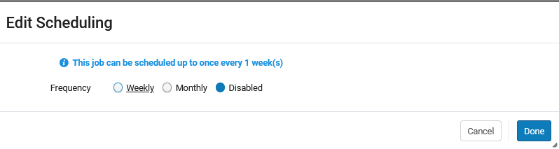
Scheduling Jobs with an open list of scheduling options
Example 2
We will click "Edit Scheduling" and then we will choose "Monthly"
Currently the job is inactive
Instead of the default "Disabled" we will choose "Monthly".
After doing so additional options will appear.

Slide 27
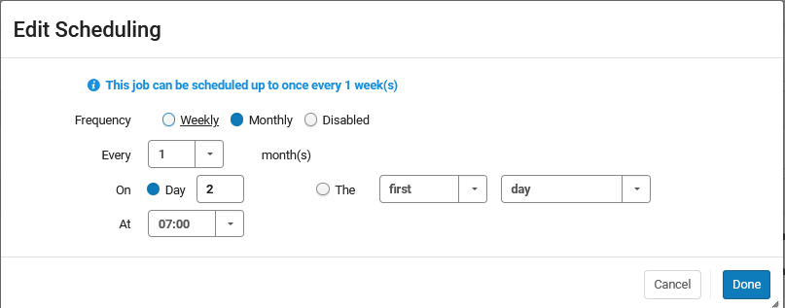
Scheduling Jobs with an open list of scheduling options
Example 2
We have chosen as follows:
  It will run every 1 month on the 2nd of the month at 07:00 AM

Slide 28
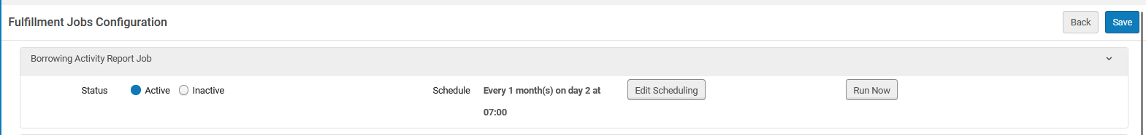
Scheduling Jobs with an open list of scheduling options
Example 2
In addition to editing the scheduling options, we have also made the job Active and clicked "Save".

Slide 29
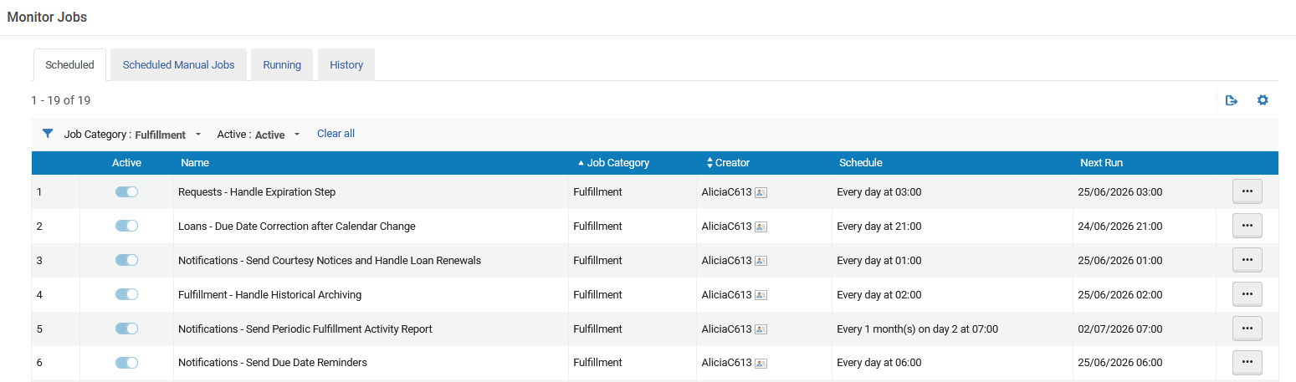
Scheduling Jobs with an open list of scheduling options
Example 2
Because this is an automated job, it appears in the "Scheduled" tab at "Admin > Manage Jobs and Sets > Monitor Jobs"
These are the scheduling options we chose.

Slide 30
Scheduling Jobs with a closed list of scheduling options

Slide 31
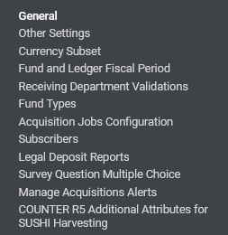
Scheduling Jobs with a closed list of scheduling options
We will use the following example to show how to schedule a job with a closed list of scheduling options.
Every 11th of the month at 20:00 the job "SUSHI harvesting job" will run.
This is an "automated job" accessed via "Configuration > Acquisitions > General > Acquisition Jobs Configuration"

Slide 32
Scheduling Jobs with a closed list of scheduling options
Here is the "SUSHI Harvesting job"
Currently the job is inactive

Slide 33
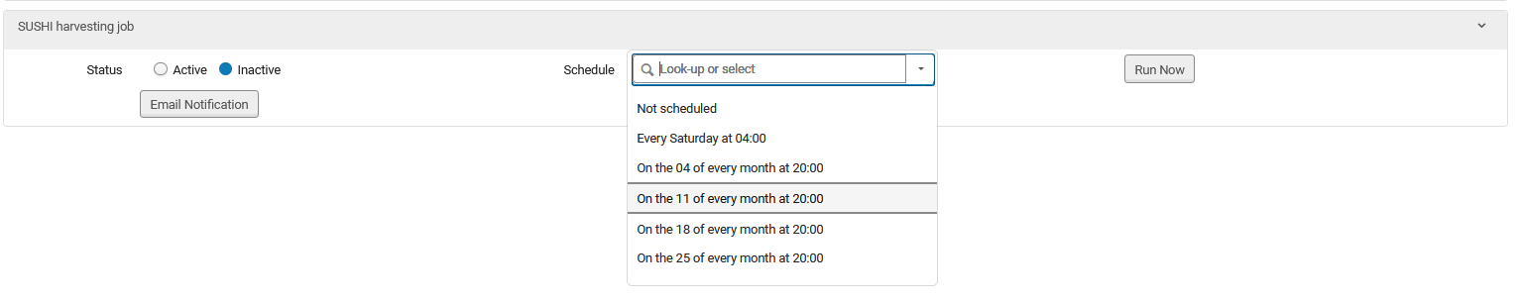
Scheduling Jobs with a closed list of scheduling options
In the "Schedule" we will choose "On the 11 of every month at 20:00"

Slide 34
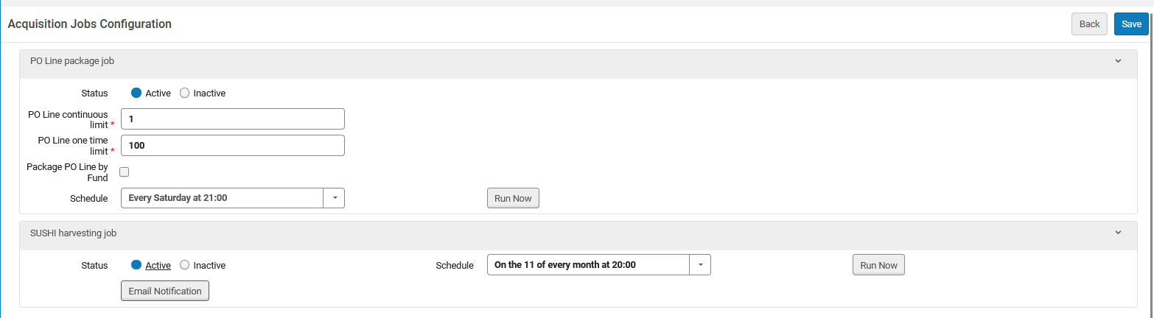
Scheduling Jobs with a closed list of scheduling options
We also change the status to "Active" and click "Save".
This was updated with what we chose.

Slide 35
Scheduling Jobs with a closed list of scheduling options
The job now appears as scheduled with the parameters we have chosen.
We can see this in the "Scheduled" tab at "Admin > Manage Jobs and Sets > Monitor Jobs"
On the next slide we are in the "Scheduled" tab and have filtered by "Job Category = Acquisitions"

Slide 36
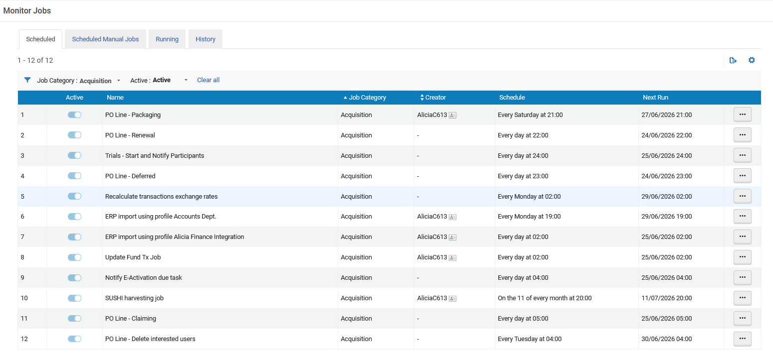
Scheduling Jobs with a closed list of scheduling options
These are the scheduling options we chose.

Slide 37

Yoel Kortick
Yoel.Kortick@clarivate.com
About Clarivate
Clarivate is a leading global provider of transformative intelligence. We offer enriched data,
insights & analytics, workflow solutions and expert services in the areas of Academia & Government, Intellectual Property and Life Sciences & Healthcare. For more information, please visit clarivate.com.
© 2026 Clarivate. All rights reserved
Clarivate and its logo, as well as all other trademarks used herein are trademarks of their respective owners and used under license.

